Slide 1




ATLIQ HARDWARES
Finance & Supply Chain Analysis
Presented By : Bilal Ahmed

Slide 2
Introduction
Atliq Hardware is a leading company that supplies product such as computer hardware and peripherals to client across the world.

Slide 3
Problem Statement
Atliq Hardware is a company that deals in computer hardware and peripheral sales, Currently, they are using Excel to manage their business data, As the company grows, maintaining and analyzing data in Excel has become challenging. To address these limitations, they aim to migrate their data to a SQL database

Slide 4
Project Overview
The project aims to analyze and extract valuable insights from the provided database, which includes information about sales, products, customers, and regions for Atliq Hardware. Specifically, it seeks to address questions related to sales reporting, market analysis, customer performance, and supply chain forecasting.

Slide 5
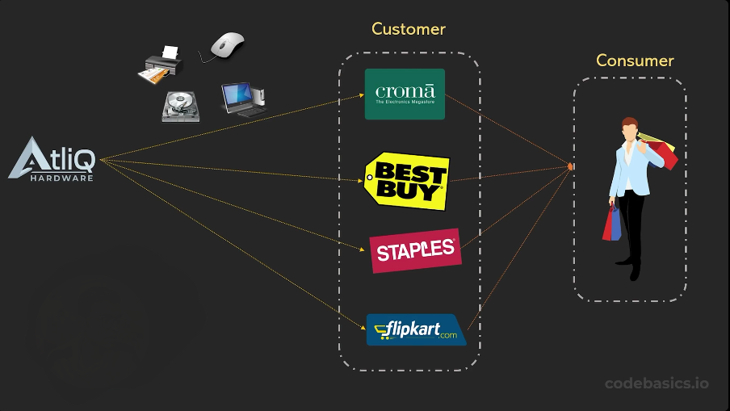
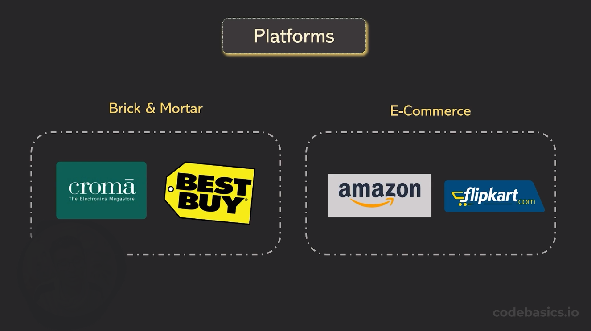
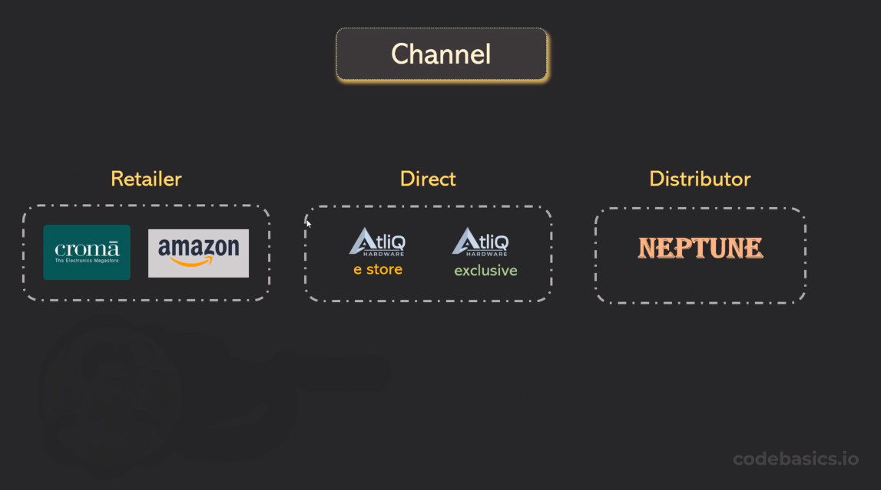
ATLIQ HARDWARE : Business Model

Slide 6
ATLIQ HARDWARE : Products
Product Division
PC
N&S
P&A
Business Laptop
Personal Laptop
Gaming Laptop
External SSD
USB Flash Drives
WIFI Extender
Internal HDD
Graphic Card
Processor
Mother Board
Mouse
Keyboard
Batteries
Segment
Note Book
Networking
Accessories
Desktop
Storage
Peripherals

Slide 7
DATA SETS
DATA Base – gdb0041
Tables
Dimension Table
Fact Table
dim_customer
dim_ product
fact_sales_monthly
fact_gross_price
fact_pre_invoice_deductions
fact_post_invoice_deductions
fact_manufacturing_cost
fact_ freight_cost
fact_forcast_monthly

Slide 8
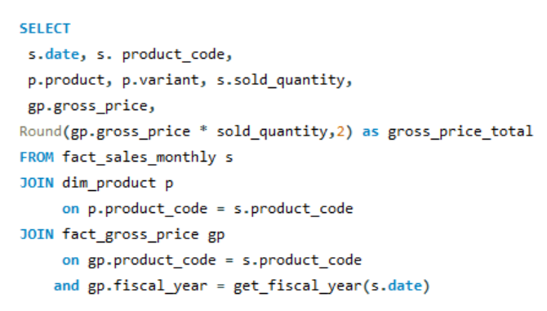
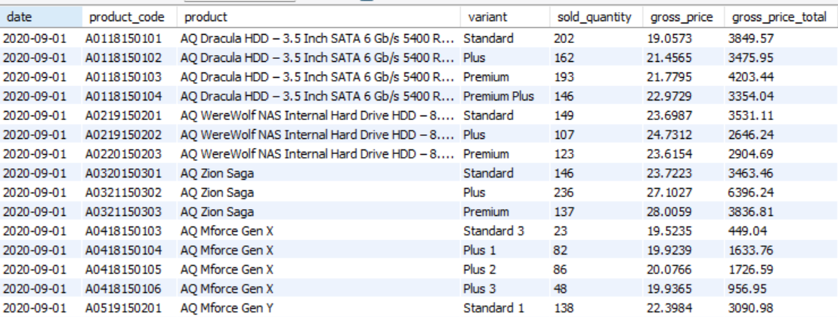
Croma India Sales Report for FY 2021
SQL Query
OutPut

Slide 9
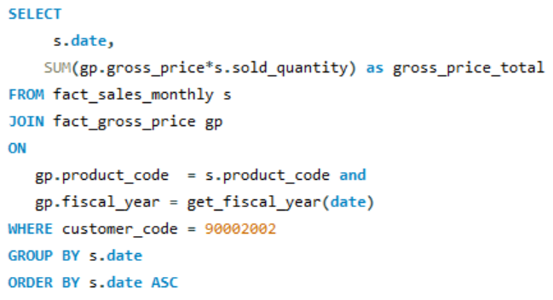
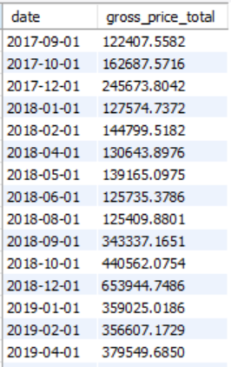
Gross Monthly Total Sales Report For Croma
SQL Query
OutPut

Slide 10
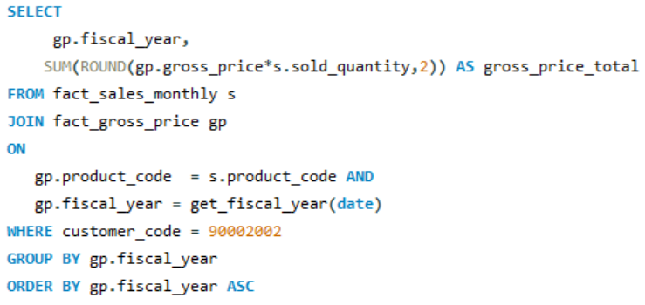
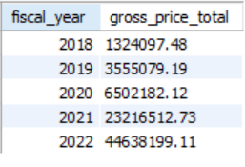
Yearly Gross Sales Report For Croma India
SQL Query
OutPut

Slide 11
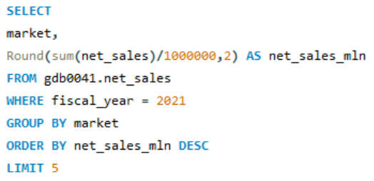
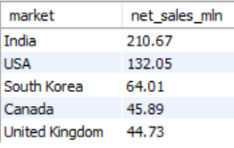
Top 5 Market For FY 2021
SQL Query
OutPut

Slide 12
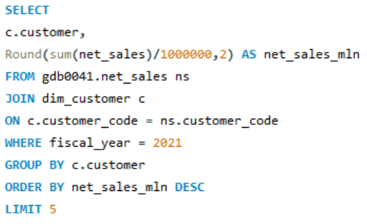
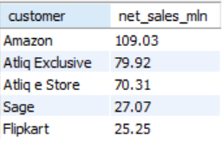
Top 5 Customer For FY 2021
SQL Query
OutPut

Slide 13
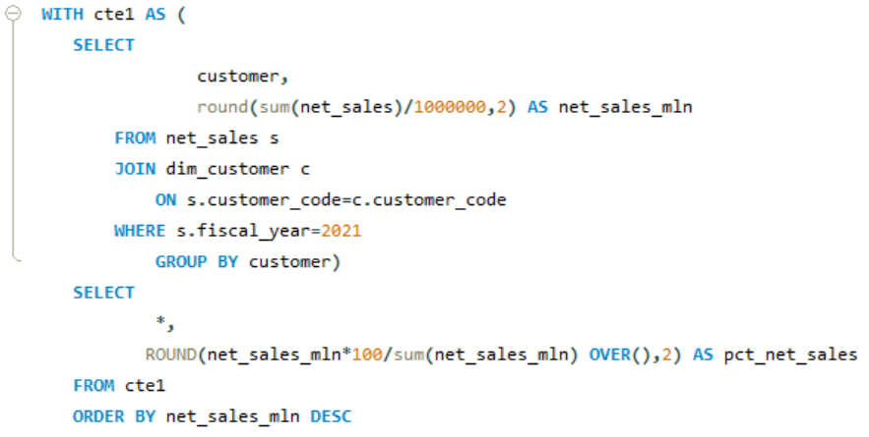
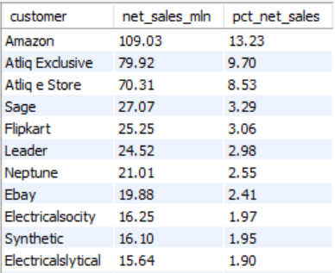
Net Sales % Share By Customer
SQL Query
OutPut

Slide 14
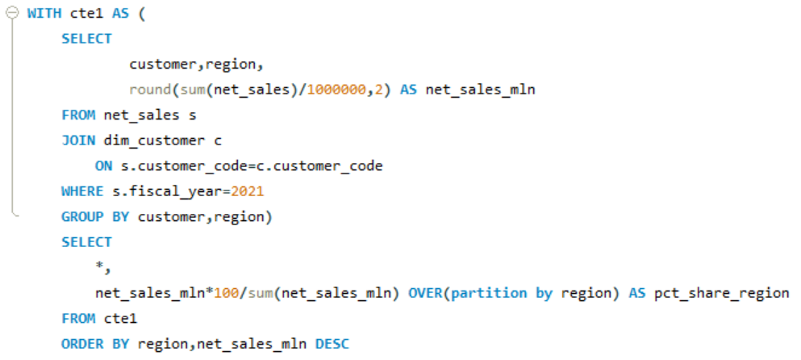
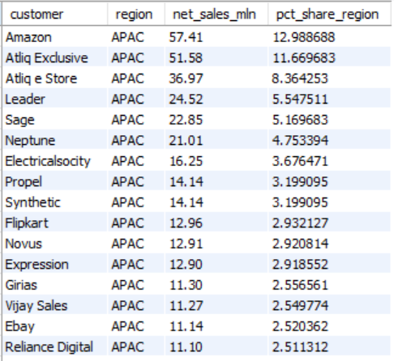
Net Sales % Share By Region
SQL Query
OutPut

Slide 15
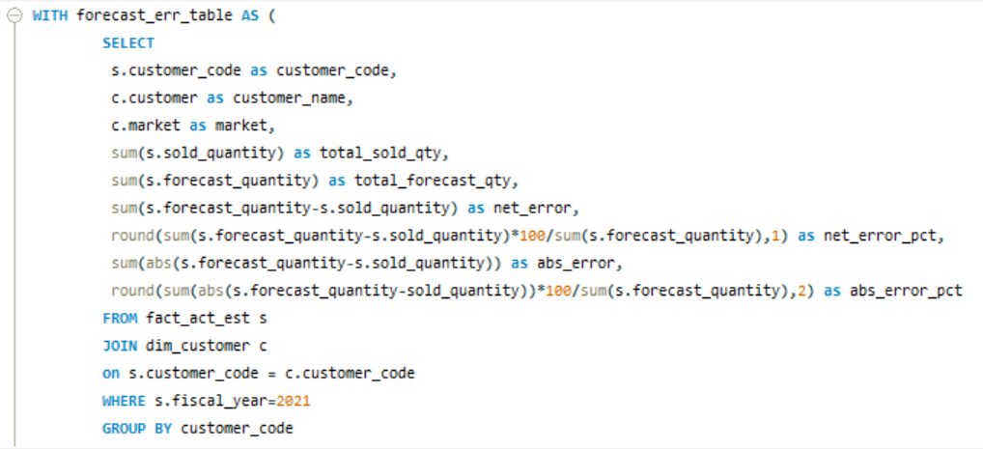
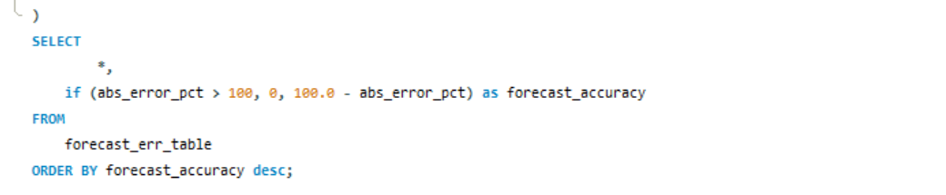
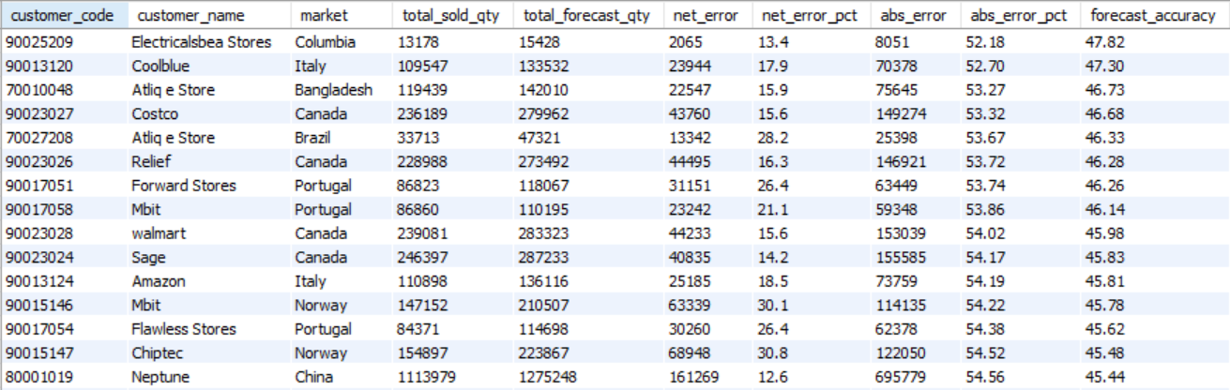
Supply Chain – Forecast Accuracy FY 2021
SQL Query
OutPut

Slide 16
Conclusion
In Year 2022 Atliq Hardware make the maximum Sale
India was the biggest market for Atliq Hardware in year 2021
AQ BZ Allin I was the highest selling product with 33.75 million net sales 2021
In 2021, Colombia, Chile, and Brazil had the lowest net sales

Slide 17

Thank You
Bilal Ahmed

